Slide 1
Midway Review
202208793 – Emma Hodkin – Honours Stage Project

Slide 2
agenda
PROJECT AIMS 3
PROJECT OBJECTIVES 4
PROGRESS SO FAR 5 – 6
PLAN OF ACTION 7
SUMMARY 8

Slide 3
Project Aims
Primarily, this project aims to provide a service which gives users the opportunity to improve their productivity and focus them onto a specific task. It will provide this opportunity through features such as timers and a calendar to monitor their progress and give a sense of accomplishment, which is all in aid of encouraging the user to keep going.
Consistency in working is a common issue with users, and as such this project aims to make consistent work convenient and reduce stress where possible.

Slide 4
Project Objectives
Provide resources for users to use to track progress within the app
Implement a method of saving recorded times into a calendar
Include features to incentivise users through gamification
Create a hosted application which stores and displays these features
Improve skills in API and backend development

Slide 5
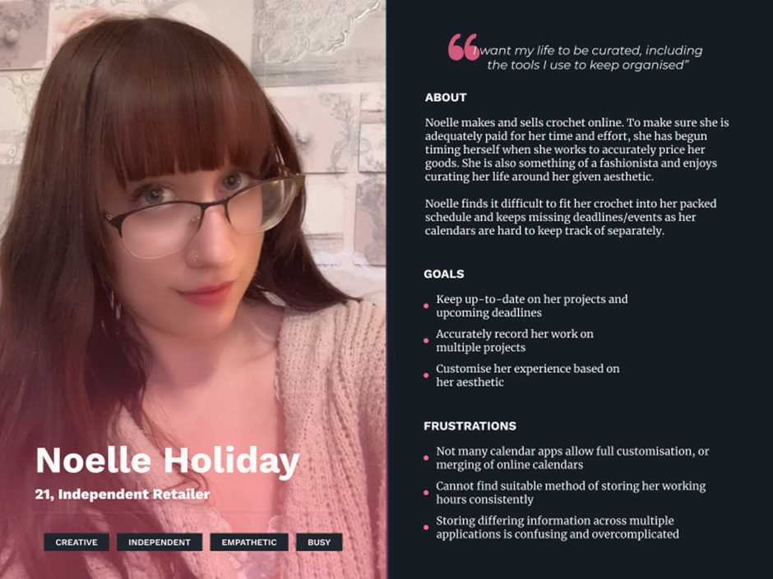
Progress so far
User Stories and Personas
Three personas, two academic and one personal, as the project is aimed primarily at students but has non-academic applications which should be considered.
Agile project, which focuses requirements into user stories to better understand user needs.
Each persona covers at least two features.
Fig 1. Persona ‘Noelle Holiday’

Slide 6
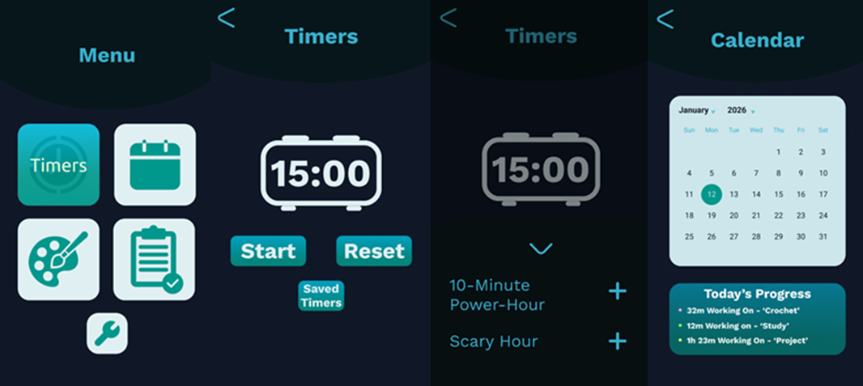
…cont.
Prototyping
Designing the general look of the app
Minimalist design as to not overwhelm, using principles learned in UIUX to make app visually appealing as well as easy to use
Each primary feature has a sub-menu
Designed in Figma
Fig 2. Figma Prototype

Slide 7
Plan of Action
Task 1: The Front-end
Implement timer, calendar, and user login locally, and test functionality
Task 2: The Back-end
The data we will need to store is known, so an SQL table can be made
This will need to be encrypted to ensure user data protection
Containerisation should be used to protect the database and the VM from unauthorised access as well as to protect the working environment of the VM
Task 3: API connection
Sending data from the app to the database and back in real time
Ensuring data can be safely sent to and from the user’s device through encryption

Slide 8
Summary
Progress has been slow so far, as even with the VMs now set up and ready there has been no actual coding. However, all of the necessary preparations have been completed such as prototyping, requirements analysis, and refinement of user stories which has helped define the scope and look of the project.
Not long remains left before the deadline but I am still confident I can complete the project within the timeframe as I gave myself many buffer weeks before the project was due for this exact reason.

